Slide 1
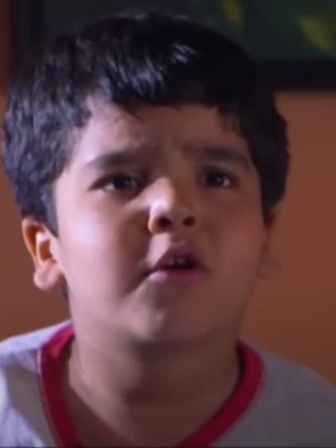
The Delightful Adventures of Little Big George
"Little Big George" is a charming short film that follows the whimsical exploits of a young boy, George, as he navigates his neighborhood with a contagious sense of wonder and curiosity. Through George's eyes, we experience the joys of childhood and the power of community.
by ROHIT Saraswat

Slide 2
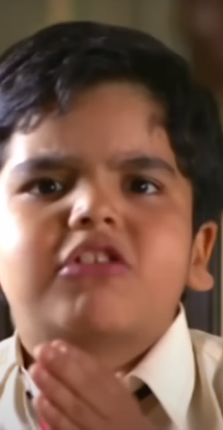
A Day in the Life of George
1
Morning Routine
George starts his day with enthusiasm, getting ready for the adventures that lie ahead.
2
Neighborhood Escapades
George's curious nature leads him to explore the nooks and crannies of his small town, encountering quirky characters along the way.
3
Community Connections
George's interactions with his friends and neighbors showcase the warmth and camaraderie of the close-knit community.

Slide 3



A Mystery Unfolds
Curious George
Solving the Mystery
A Heartwarming Reveal
George's inquisitive nature is piqued when he overhears a conversation about a "big surprise" in the neighborhood.
With a keen eye and a determined spirit, George sets out to uncover the secret, encountering a colorful cast of characters along the way.
George's persistence pays off as he discovers the "big surprise" – a delightful community event that brings the neighborhood together.

Slide 4




The Heartbeat of the Community
Kindness and Compassion
Friendship and Teamwork
Embracing Curiosity
Perseverance Pays Off
The film showcases the importance of kindness and community spirit, as the neighbors come together to support one another.
George's interactions with his friends highlight the value of friendship and the joy of working together.
The film encourages viewers to embrace their natural curiosity and explore the world around them.
George's determination to solve the mystery teaches the importance of perseverance and the rewards it can bring.

Slide 5
Charming Characters
George
George's Mother
The protagonist, George, is a lively and intelligent boy with a penchant for adventure and a kind-hearted nature.
A caring and supportive figure, George's mother represents the nurturing side of his world.
Neighborhood Friends
Quirky Neighbors
George's friends add a layer of fun and camaraderie, showcasing the importance of friendship and teamwork.
The various eccentric characters George encounters provide comic relief and contribute to the small-town charm.

Slide 6




Lessons Learned
Curiosity
Perseverance
Community
Friendship
George's adventures underscore the importance of curiosity and the joy of exploring the world.
The film highlights the value of perseverance and how it can lead to rewarding outcomes.
The heartwarming climax emphasizes the significance of community spirit and kindness.
George's interactions with his friends demonstrate the importance of friendship and teamwork.

Slide 7




Cinematic Artistry
Vibrant Cinematography
The film's cinematography captures the essence of the small, close-knit community with bright, vibrant colors and playful camera angles.
Enchanting Soundtrack
The film's musical score complements the light-hearted tone, enhancing the emotional impact of key scenes.
Immersive Experience
Together, the visual and auditory elements create a delightful and immersive viewing experience for the audience.

Slide 8
A Heartwarming Delight
Humor
Warmth
Charm
George's adventures are filled with comedic moments that bring smiles to the audience's faces.
The film's portrayal of family, friendship, and community evokes a sense of heartwarming nostalgia.
The delightful characters, vibrant visuals, and lighthearted tone combine to create a truly charming viewing experience.

Slide 9

Conclusion
1
Captivating Story
2
Meaningful Messages
3
Delightful for All
This charming film is a delight for viewers of all ages, leaving them with a smile and a renewed appreciation for the wonders of childhood.
"Little Big George" is a heartwarming and entertaining short film that captivates its audience with humor, charm, and valuable life lessons.
Through George's eyes, the film reminds us of the beauty of curiosity, the strength of perseverance, and the joy of community and friendship.

